Slide 1

You Were Dead, But God
2:1 – 10
Week 17
18 May 2022

Slide 2

Ephesians overview
Having expressed his desire that his readers might know the exceeding greatness of God’s power toward those who believe (1:19), Paul reminds them of how they had been dead in sin but made alive together with Christ.
Indeed, they were raised and made to sit together with Christ in the heavenly places, that God might show even more riches of His grace in the ages to come. All this God did by His love, grace, and mercy (2:1-5).
While it involved their faith, it did not involve any works whereby one could boast. The end result is that they have been created in Christ to walk in good works, as God planned beforehand (2:6-10).

Slide 3
Ephesians overview
Paul also wants them to remember how far they have come as Gentiles, courtesy of Jesus Christ. Once strangers from the promises made to Israel and without God in the world, they can now draw near through the blood of Jesus.
By His death on the cross Jesus abolished the law of commandments which separated Jews and Gentiles, and has reconciled them both to God in one body. The Gentiles can therefore be fellow-citizens and members of God’s family; they are also part of that grand temple being built upon the foundation of the apostles and prophets with Jesus as the cornerstone, in which they serve as a habitation of God in the Spirit (2:11-22).

Slide 4

You Were Dead, But God

Slide 5
Ephesians 2:1 – 10
The highest point in the continental United States is Mount Whitney in California at about 14,500 feet. At that altitude in the Sierra Nevada Mountains, one can see eighty miles in the distance the Mojave Desert and Death Valley, the lowest point in the United States, at 282 feet below sea level.
Think about it ! In just eighty miles, one could climb from a suffocating 134 degrees in the shade to crisp, cool mountain air in the bright sun. What a contrast! One place is the top of the world, the other the bottom. One place is perpetually cool, the other relentlessly hot.
From Mt. Whitney you can look down on all of life. From Death Valley you can only look up to the rest of the world.

Slide 6
Ephesians 2:1 – 10
It’s hard to imagine a more extreme contrast, but one does exist—not in the physical world but in the spiritual. In Ephesians 2:1-10, Paul describes the “Death Valley” into which all of us are born (2:1-3), as well as the glorious change of location God has provided through Christ’s death and resurrection (2:4-10).
Christ has rescued us from the desert of our sinfulness and exalted us to the highest mountain peak of His righteousness. Paul’s description of the barren state of our souls prior to our salvation will seem overwhelmingly bleak, especially in contrast to the optimistic “I’m okay, you’re okay” philosophy that pervades our modern culture.

Slide 7
Ephesians 2:1 – 10
The content of this crucial passage in Paul’s letter to the Ephesians can be outlined by asking four questions:
What was life like prior to God’s gracious intrusion? (2:1-3)
What did God do for us and why did He do it? (2:4-7)
How can we receive the gift of salvation? (2:8-9)
What difference does salvation make in my life? (2:10)

Slide 8


Slide 9
Ephesians 2:1 – 3
¹As for you, you were dead in your transgressions and sins, ²in which you used to live when you followed the ways of this world and of the ruler of the kingdom of the air, the spirit who is now at work in those who are disobedient. ³All of us also lived among them at one time, gratifying the cravings of our flesh and following its desires and thoughts. Like the rest, we were by nature deserving of wrath.

Slide 10
Ephesians 2:1 – 3
#1 “What was life like prior to God’s gracious intrusion?” The answer is simple: We were dead, enslaved, and condemned. Many regard these verses as a classic description of the doctrine of “total depravity” or “spiritual death.” Though outwardly we looked very much alive, inside we were cut off from true life because we were severed from God—the Source of life.
We were, as it were, buried in our own trespasses and sins (2:1), as a corpse is buried in dirt. We weren’t merely grubby; we were interred! And just like a dead body resting six feet under, we were completely incapable of extricating ourselves from our grave situation.

Slide 11
Ephesians 2:1 – 3
Covered by their trespasses and sins, those without Christ found themselves over their heads in sin. In fact, the unsaved “still walk” in their trespasses and sins, following the path set by Satan, the “prince of the power of the air” (2:2).
So potent is the power of Satan that he can get people to believe that truth is a lie and that a lie is the truth. He fills the world with temptations and traps, and he reigns over his kingdom of darkness like a malevolent dictator oppressing his powerless victims.
Paul even includes himself in this category: “Among [the sons of disobedience] where we too formerly lived” (2:3). We all lived among the dead, having the exact same nature as they have.

Slide 12
Ephesians 2:1 – 3
Paul then describes with a triple punch the kind of lifestyle all of us once experienced (2:3):
We lived in the lusts of our flesh (emotional depravity).
We indulged the desires of the flesh (physical depravity).
We indulged the desires of the mind (rational depravity).
These are not three completely separate things but three aspects of our human condition as totally depraved, spiritually dead people . . .

Slide 13
Ephesians 2:1 – 3
EMOTIONAL DEPRAVITY. When Paul says we once lived in the “lust of our flesh,” he used the Greek word translated “lust,” which is a neutral term that simply means “deep desire.” When governed by the flesh, these “deep desires” always lead us in a downward spiral. Uncontrolled desires and fickle feelings drive those who are wallowing in spiritual death into ever-deeper emotional instability.
PHYSICAL DEPRAVITY. Paul then says that the unsaved sinner had no choice but to indulge the “desires of the flesh.” The word “desire” here is the Greek word for “the will”—our decision-making capacity. When choices are presented to the lost person, he or she usually makes decisions based on physical, not spiritual, priorities.

Slide 14
Ephesians 2:1 – 3
That’s how the old nature thinks. Materialism, physical appearance, external beauty—these things dominate the lives of those walking in spiritual death.
RATIONAL DEPRAVITY. Finally, Paul mentions the intellectual sphere, the rational capacity of a person. Children of disobedience indulge the desires “of the mind.” Not only are their thought lives governed by self-centeredness, but they are also controlled by self-deception, rationalization, confusion, and irrational beliefs.
Twisted thinking characterizes those who lack spiritual life from God. As Paul continues to describe the horrible condition of fallen humanity, he delivers a deathblow to the “we’re all fine” philosophy.

Slide 15
Ephesians 2:1 – 3
Paul sums up the condition of lost people by emphasizing their nature and their end. They are “by nature children of wrath” (2:3). By using the term “nature,” he refutes anybody who might say, “Well, I’m basically a good person. I just have a few bad habits.”
Paul trumps those who claim, “We all have good and bad in us.” Rather, he shows that all human beings apart from Christ are “essentially and unchangeably bad.” Worse than this, our totally corrupt nature results in condemnation.
Fallen humans are “children of wrath”—those who are, by default, under the wrath of God (cf. John 3:36; Rom 1:18).

Slide 16
Ephesians 2:1 – 3
What a wretched condition! What a tangled knot of heart, body, and mind! What a dreadful, irresolvable destination for all people apart from Christ!
If Paul had stopped writing at 2:3, we would have been abandoned to utter despair. The apostle suddenly reverses course, however, with two miraculous words—two of the greatest words in all of Scripture: “But God . . .”
That changes everything!

Slide 17


Slide 18
Ephesians 2:4 – 7
⁴But [God] because of his great love for us, God, who is rich in mercy, ⁵made us alive with Christ even when we were dead in transgressions—it is by grace you have been saved. ⁶And God raised us up with Christ and seated us with him in the heavenly realms in Christ Jesus, ⁷in order that in the coming ages he might show the incomparable riches of his grace, expressed in his kindness to us in Christ Jesus.

Slide 19
Ephesians 2:4 – 7
#2 “What did God do for us and why did He do it?” Paul begins his answer with those two great words: “But God . . .” In the midst of our horrific condition, when we were destined for damnation, already condemned and suffering the effects in our bodies and souls, God accomplished a decisive rescue mission. He sent Jesus Christ—fully human and undiminished deity—to save sinners from their hopeless plight (John 3:16).
While we were dead in our sins—ignorant, unwilling, and unable to change our condition even one degree—God “made us alive together with Christ . . . and raised us up with Him, and seated us with Him in the heavenly places in Christ Jesus” (2:5-6).

Slide 20
Ephesians 2:4 – 7
No wonder this is called the “good news” of Jesus Christ! Grace abounds! His resurrection from the dead and exaltation into heaven have become ours by virtue of God’s work. No longer are we dead and condemned! Now we’re alive and blessed! This is what we call being “born again,” made alive in the eyes of God and spiritually incorporated into Christ (John 3:3, 7).
Now believers are indwelled by the Holy Spirit, who makes us willing and able to do what was impossible in our spiritually dead state: to believe and to live in a way that’s pleasing to God (Phil 2:12-13). Paul associates the believer’s new position directly with the work of Jesus Christ in His death, resurrection, and exaltation.

Slide 21
Ephesians 2:4 – 7
In fact, what Paul said about Jesus Christ’s position in Ephesian 1:20-23, he now applies to believers in a spiritual sense in 2:4-6. Thus, Christ’s death to sin, resurrection to righteousness, and exaltation to the right hand of God are reckoned to the believer—regarded as applying as fully to the born-again Christian as they do to his or her Savior, Jesus Christ.
This reckoning is not simply theoretical. It also anticipates a day “in the ages to come” when all Christians will be resurrected bodily, just as Christ was (2:7).
Believers have been made alive together with Christ (2:5). We are no longer spiritually dead; we have been spiritually resurrected, transferred from death to life (John 5:24; Col 2:13-14).

Slide 22
Ephesians 2:4 – 7
Therefore, God also raise us up with Christ and seated us in the heavenly places (2:6). In anticipation of our future resurrection and glorification, we can now begin to live new lives of righteousness through the work of the Holy Spirit (Gal 5:16; Phil 3:20). We are “unchained” . . . our hearts have been freed! Paul is so certain of our future perfection in Christ that he describes this reality as a past event (2:6).
This sudden, miraculous turn from death to life brings up the second part of the question answered in these verses: Why did God do it? Why would he go to such lengths to rescue dead, condemned, sin-stained, rebellious people? Clearly it had nothing to do with our own merit, worthiness, works, or untapped potential.

Slide 23
Ephesians 2:4 – 7
Ephesians 2:4 begins by describing God as “rich in mercy.” The Lord abounds in “great love,” which He demonstrated in His saving initiative toward us. His merciful character stayed His hand of justice—getting what we deserve—and exchanged it for grace—getting what we don’t deserve.
Grace is God’s unmerited favor unconditionally demonstrated to the undeserving. Notice the parenthetical explanation that puts the entire rescue operation in proper theological perspective: “by grace you have been saved.” Paul interrupts his normal train of thought from resurrection to exaltation by inserting this clarification, reminding us that none of this comes from ourselves; it comes from a loving, merciful, gracious Almighty God (2:7).

Slide 24


Slide 25
Ephesians 2:8 – 9
⁸For it is by grace you have been saved, through faith—and this is not from yourselves, it is the gift of God— ⁹not by works, so that no one can boast.

Slide 26
Ephesians 2:8 – 9
#3 “How can we receive the gift of salvation?” Paul has painted a vivid picture of the stunning contrasts between darkness and light, damnation and salvation, death and resurrection. Now, in one of the clearest passages on salvation by grace through faith in the entire Bible, Paul describes the means by which one receives this incomparable gift of new life.
Paul begins this explanation by repeating—word for word—the phrase from 2:5: “By grace you have been saved.” Grace is the basis for everything God has done for us. Grace motivated the Father to choose us in Christ before the foundation of the world (1:4-6). Grace provided the one-time payment for eternal redemption—the blood of Christ, who came to earth and died for the forgiveness of sin (1:7).

Slide 27
Ephesians 2:8 – 9
And by grace alone we receive this forgiveness and salvation—grace apart from any merit of our own (2:8-9). Though grace is the objective basis for our salvation, Paul also mentions an equally important subjective means of receiving this grace: faith.
We are saved by grace, but we appropriate this grace through faith. “Faith” simply means trust, reliance, or dependence upon someone or something. Faith is the wholehearted acceptance that what God says is true, trusting that the gift of salvation is exactly as promised.
The grace of salvation is received when God opens our blind eyes to this gospel, enabling us to understand its claims and to accept its promise of forgiveness for all who believe.

Slide 28
Ephesians 2:8 – 9
When the shroud of death is lifted from our hearts, our minds are illuminated to have faith in Christ’s death for our sins and His resurrection from the dead. This faith—apart from any works—is then the sole means of entering into an eternal relationship with the Father through Jesus Christ the Son by the regenerating work of the Holy Spirit.
This entire salvation package is “not of yourselves,” but is “the gift of God” (2:8). Paul specifies what he means by “not of yourselves”: this salvation gift is “not as a result of works, so that no one may boast” (2:9). Simply put, God initiated our salvation, He implemented it, and He receives all the glory for it. In contrast, we could do nothing to start it, cannot contribute anything to it, and therefore can take no credit for it.

Slide 29


Slide 30
Ephesians 2:10
¹⁰For we are God’s handiwork, created in Christ Jesus to do good works, which God prepared in advance for us to do.

Slide 31
Ephesians 2:10
#4 “What difference does salvation make in my life?” Finally, Paul ends this first section of his letter by answering our question with this commonly overlooked verse (2:10), we are God’s “workmanship.” In other words, we are His masterpiece, designed for action. God has good works for us to do that He “prepared beforehand”—before we were even born.
God’s plan for our lives does not end when we believe the message of the gospel and receive eternal salvation by grace through faith apart from works. Rather, this experience simply marks the beginning of our Christian life as new creatures “in Christ Jesus” (2:10).

Slide 32
Ephesians 2:10
God’s plan extends beyond salvation to sanctification, beyond standing in grace to walking in good deeds. Therefore, the good works mentioned in 2:10 have nothing to do with earning salvation. Paul clearly ruled that scenario out in 2:9 when he emphasized that we are not saved “as a result of our works.”
Paul refers to works “of yourselves” (2:8), works done in our own strength prior to salvation with the express intention of trying to save ourselves or to contribute something to God’s grace. This is absolutely impossible.

Slide 33
Ephesians 2:10
Ephesians 2:10, on the other hand, refers to the good works of those who are already born-again believers in Christ and who are now empowered by the Spirit to determine and then do things that please God (Phil 2:13).
Since all of this—from the first to last—is God’s work, He deserves all the credit. Unfortunately, many Christians want to claim a portion of the responsibility for their salvation. They believe that God makes a free offer, but that we must exercise our own initiative and believe by our own power, or receive it by some action like prayer, repentance, baptism, or joining some local church.

Slide 34
Ephesians 2:10
Or they believe that once a person has been saved, they must continue to perform up to par in order to “stay” saved. These approaches mirror the world’s tendency to exalt human effort.
Such thinking resists the truth that in and of ourselves we are utterly helpless; we need a sovereign Savior who can save us in spite of ourselves.
Until we finally give up any notion of entitlement, contribution, or partnership in salvation, we will never truly appreciate that work that Christ has done for us—and is doing in us.

Slide 35
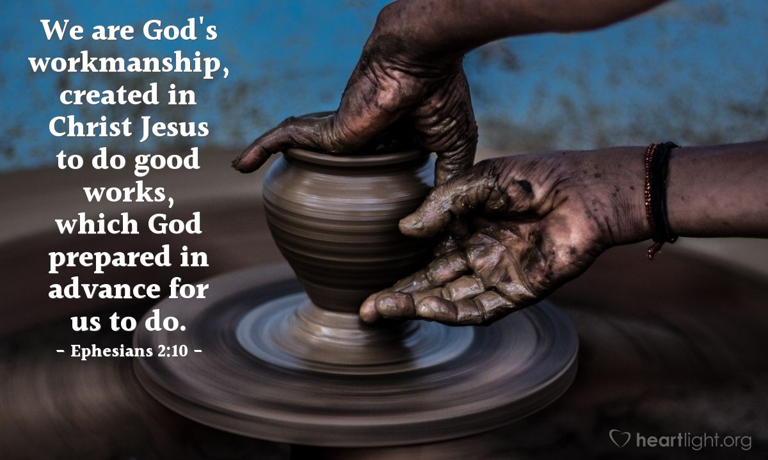

Slide 36
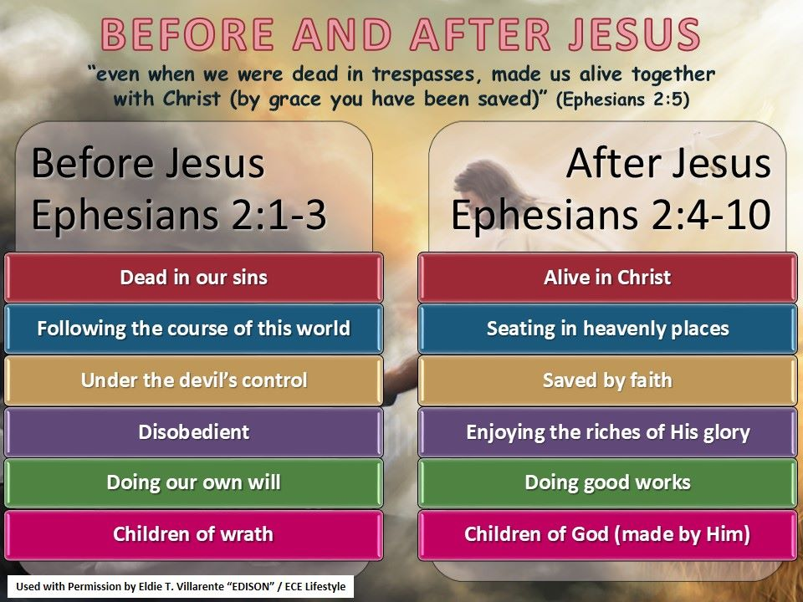

Slide 37



Slide 38
NEXT CLASS – 25 May 2022
Book of Ephesians
Before next class, read the below verses in the NIV and in one other versions of the Bible, i.e., NKJV, NRSV, KJV, CEV, etc …
Chapter 2:11 – 22
“Destroying the Wall to Build the Temple”

